Slide 1
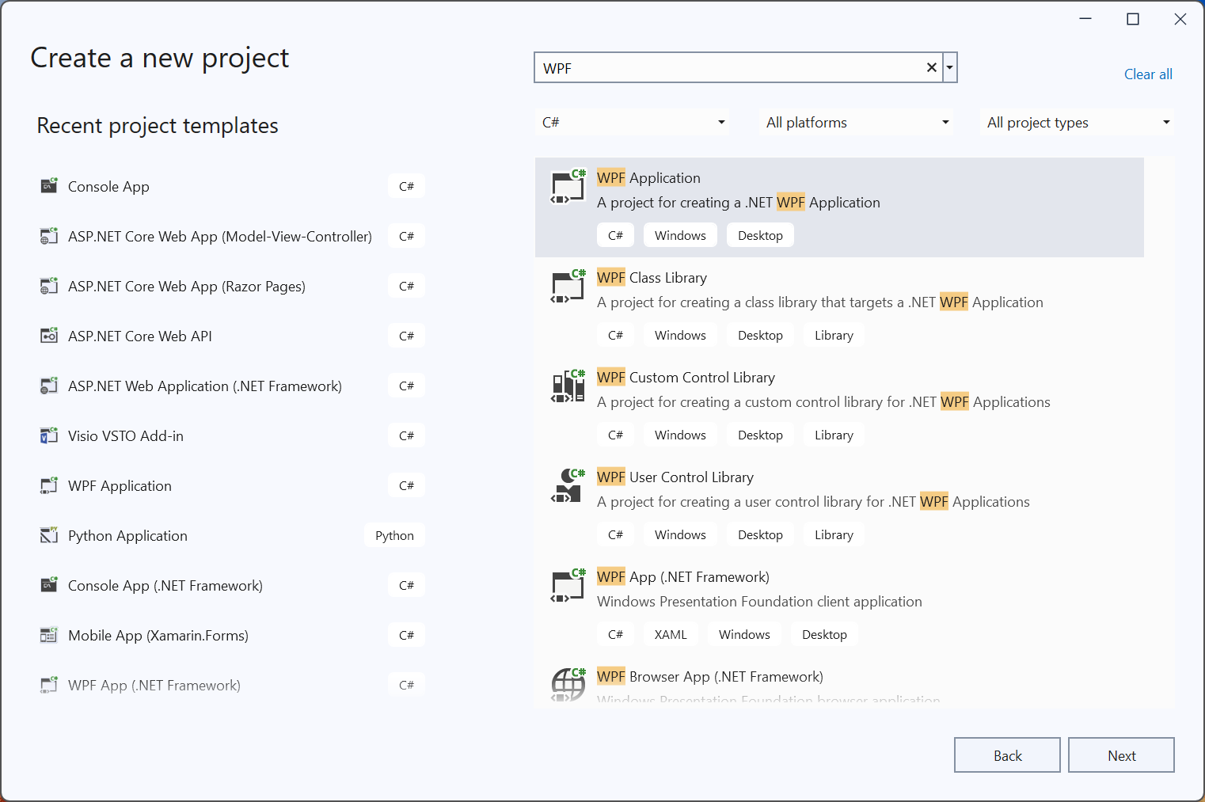

Slide 2
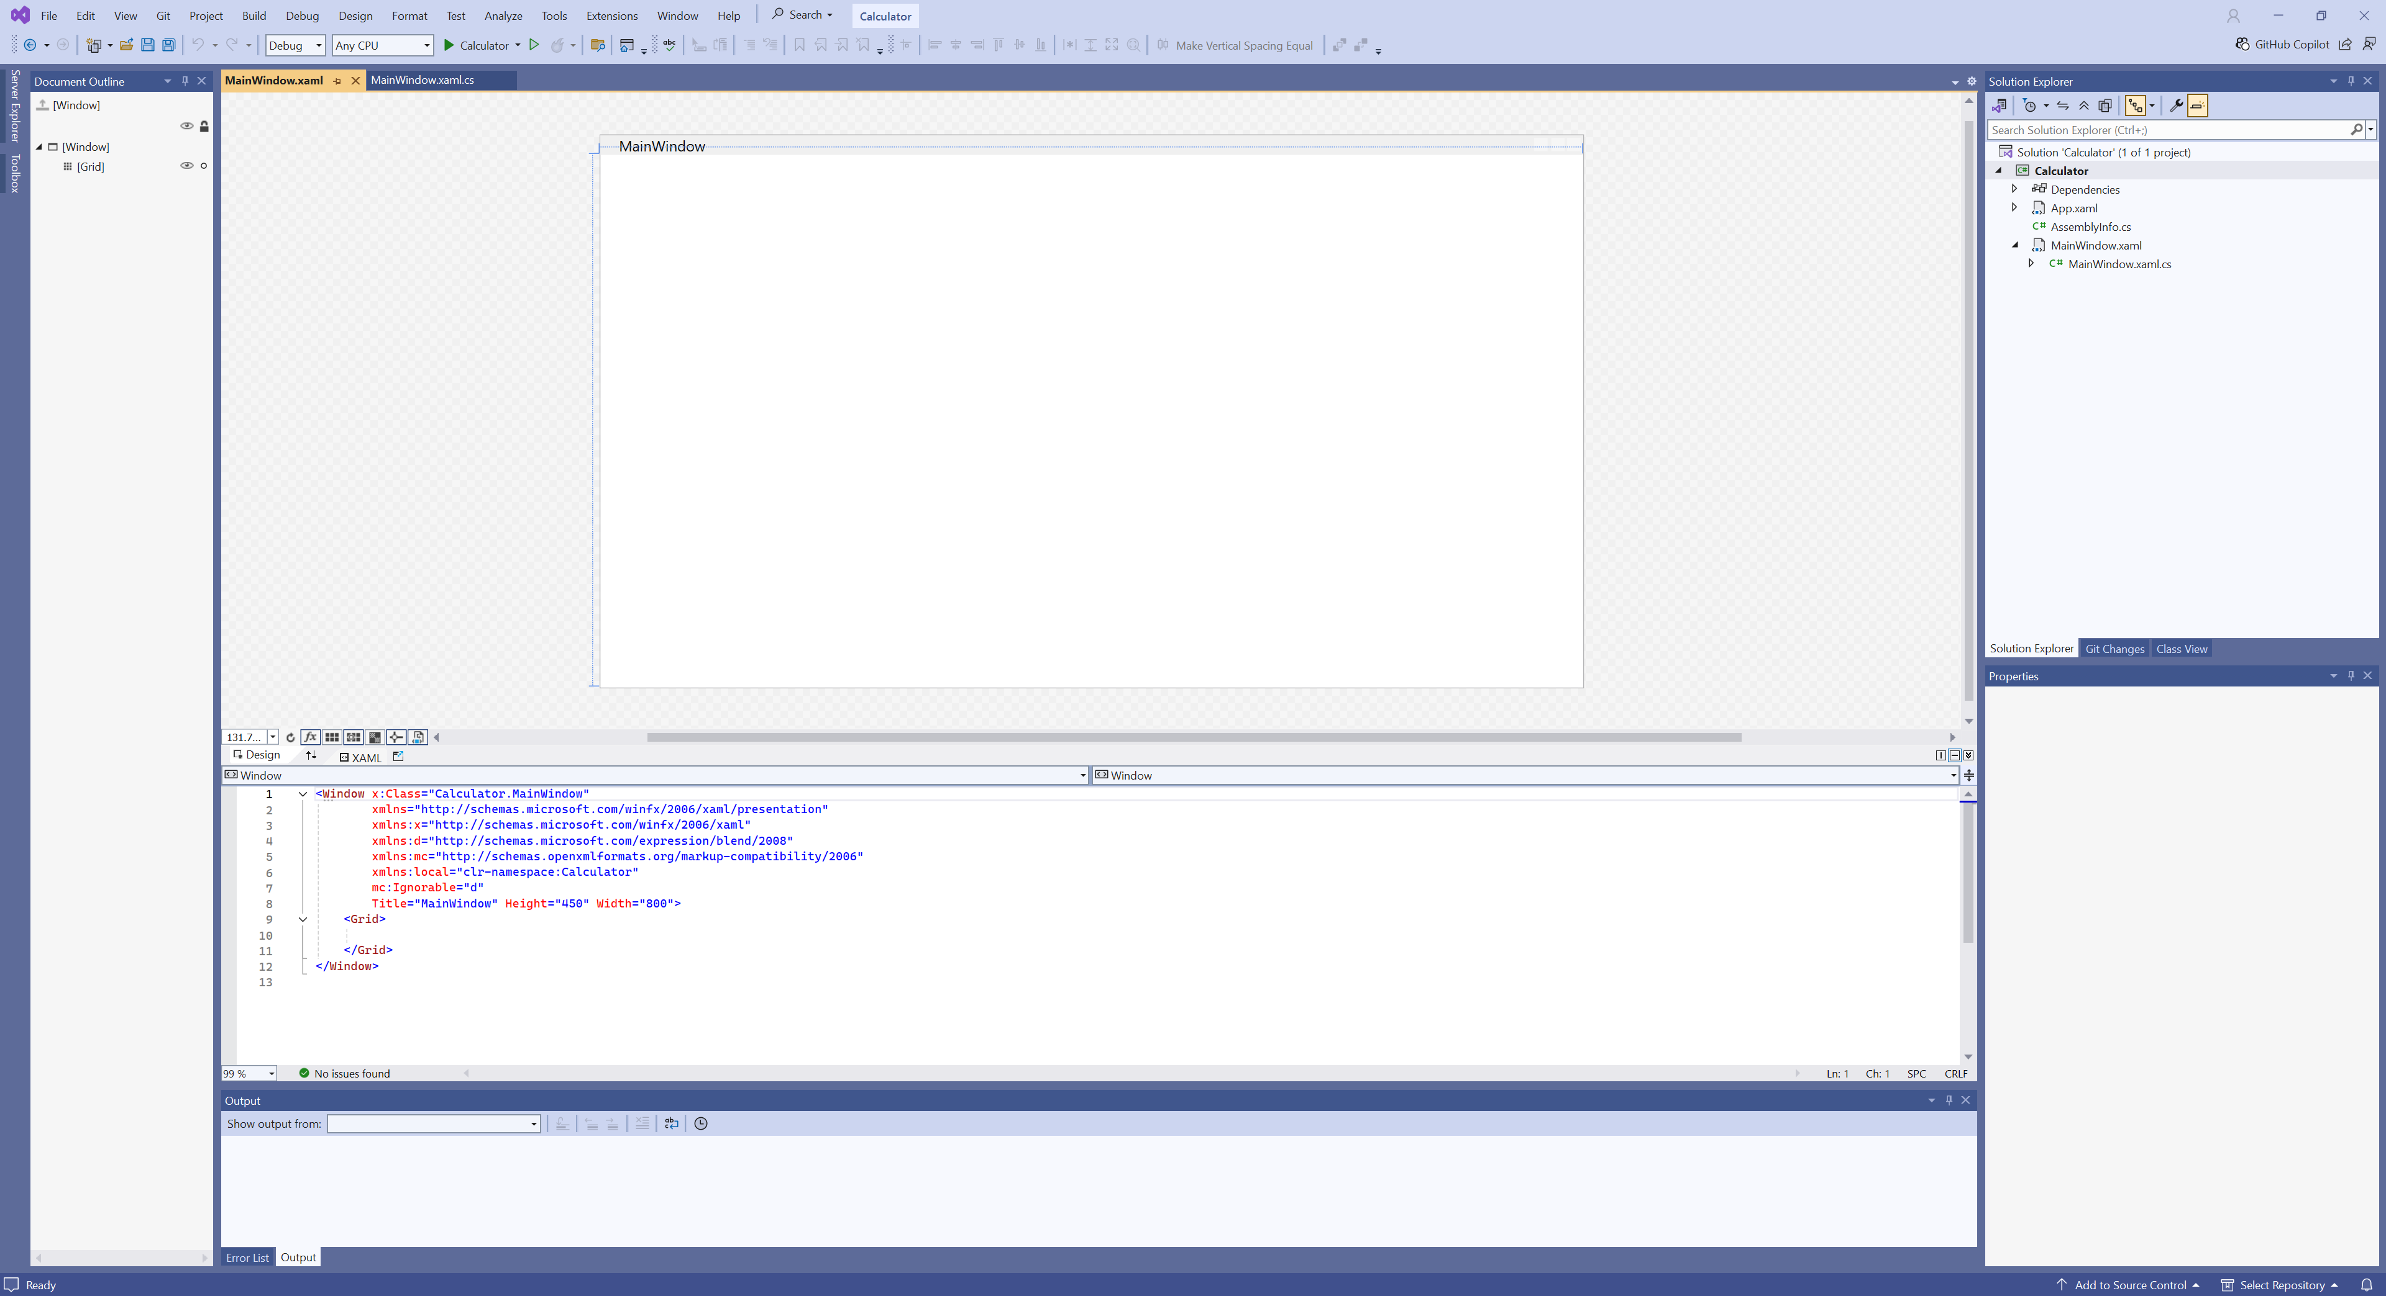

Slide 3
using System.Text;
using System.Windows;
using System.Windows.Controls;
using System.Windows.Data;
using System.Windows.Documents;
using System.Windows.Input;
using System.Windows.Media;
using System.Windows.Media.Imaging;
using System.Windows.Navigation;
using System.Windows.Shapes;
namespace Calculator
{
/// <summary>
/// Interaction logic for MainWindow.xaml
/// </summary>
public partial class MainWindow : Window
{
public MainWindow()
{
InitializeComponent();
}
}
}
<Window x:Class="Calculator.MainWindow"
xmlns="http://schemas.microsoft.com/winfx/2006/xaml/presentation"
xmlns:x="http://schemas.microsoft.com/winfx/2006/xaml"
xmlns:d="http://schemas.microsoft.com/expression/blend/2008"
xmlns:mc="http://schemas.openxmlformats.org/markup-compatibility/2006"
xmlns:local="clr-namespace:Calculator"
mc:Ignorable="d"
Title="MainWindow" Height="450" Width="800">
<Grid>
</Grid>
</Window>

Slide 4
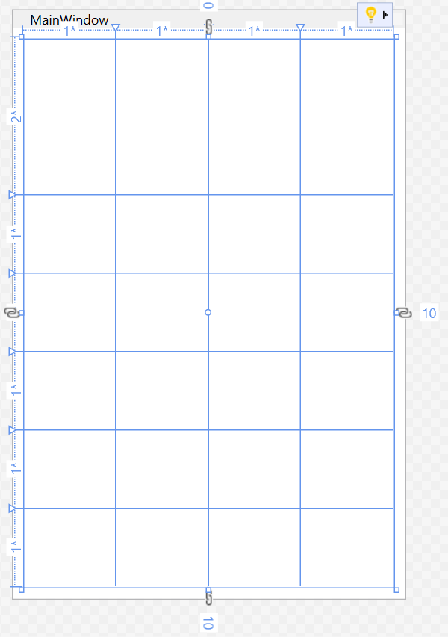
Define Grid
<Grid Margin="10">
<Grid.ColumnDefinitions>
<ColumnDefinition Width="*"/>
<ColumnDefinition Width="*"/>
</Grid.ColumnDefinitions>
<Grid.RowDefinitions>
<RowDefinition Height="2*"/>
<RowDefinition Height="*"/>
<RowDefinition Height="*"/>
<RowDefinition Height="*"/>
<RowDefinition Height="*"/>
<RowDefinition Height="*"/>
</Grid.RowDefinitions>
</Grid>

Slide 5
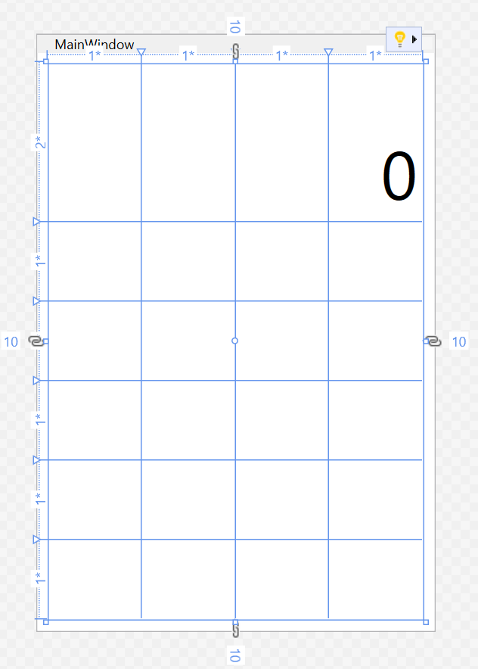
<Grid ...>
...
<Label Content="0“
Grid.ColumnSpan="4"
HorizontalAlignment="Right"
VerticalAlignment="Bottom"
FontSize="60"/>
...
</Grid>

Slide 6
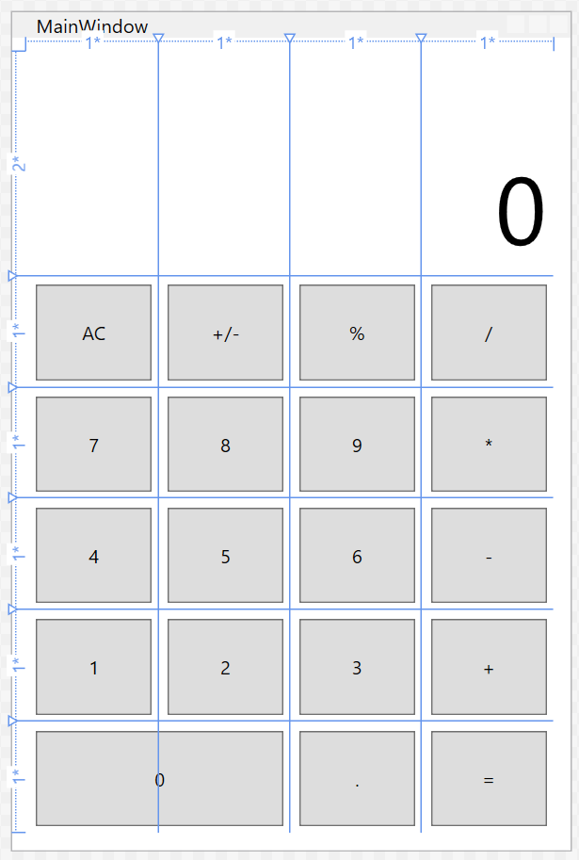
HelloWorld.cs
1 2 3 4 5 6 7 | <Grid ...> ... <Button Content="=" Margin="5" Grid.Column="3" Grid.Row="5"/>... </Grid>

Slide 7
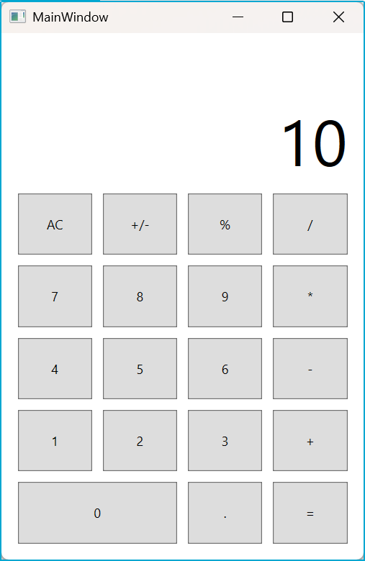
<Grid ...>
...
<Label Content="0“
x:Name="resultLabel"
Grid.ColumnSpan="4"
HorizontalAlignment="Right"
VerticalAlignment="Bottom"
FontSize="60"/>
...
</Grid>
...
namespace Calculator
{
/// <summary>
/// Interaction logic for MainWindow.xaml
/// </summary>
public partial class MainWindow : Window {
public MainWindow() {
InitializeComponent();
resultLabel.Content = "10";
}
}
}

Slide 8
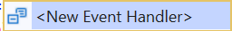
<Button Content="0"
x:Name="zeroButton"
Click="zeroButton_Click"
Margin="5"
Grid.Column="0"
Grid.Row="5"
Grid.ColumnSpan="2"/>
private void zeroButton_Click(object sender, RoutedEventArgs e)
{
if (resultLabel.Content.ToString() != "0")
resultLabel.Content += "0";
}
private void zeroButton_Click(object sender, RoutedEventArgs e)
{
if (Convert.ToDouble(resultLabel.Content) != 0)
resultLabel.Content += "0";
}

Slide 9
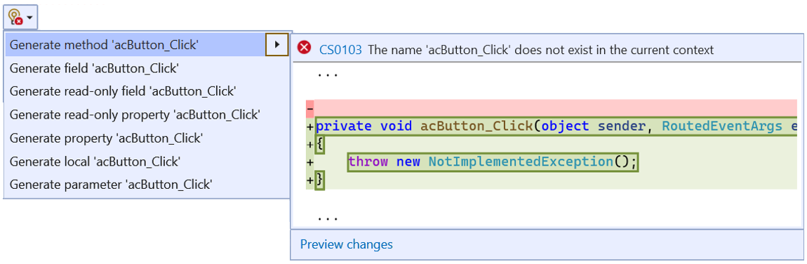
Create an event handler from C#
public MainWindow()
{
InitializeComponent();
acButton.Click += acButton_Click;
}
Ctrl
+
.
private void acButton_Click(object sender, RoutedEventArgs e)
{
throw new NotImplementedException();
}
private void acButton_Click(object sender, RoutedEventArgs e)
{
resultLabel.Content = "0";
}

